Slide 1
Parsing
Using theory of CFG

Slide 2
Program File
Machine Code
v = 5;
if (v>5)
x = 12 + v;
while (x !=3) {
x = x - 3;
v = 10;
}
......
Add v,v,5
cmp v,5
jmplt ELSE
THEN:
add x, 12,v
ELSE:
WHILE:
cmp x,3
...
Compiler

Slide 3
Compiler
Lexical
analyzer
parser
Input String
Output
Program
file
machine
code

Slide 4
Lexical analyzer:
Recognizes the lexemes of the
input program file:
Keywords (if, then, else, while,…),
Integers,
Identifiers (variables), etc
It is built with DFAs (based on the
theory of regular languages)

Slide 5
Parser:
Knows the grammar of the
programming language to be compiled
Constructs derivation (and derivation tree)
for input program file (input string)
Converts derivation to machine code

Slide 6

Example Parser
PROGRAM STMT_LIST
STMT_LIST STMT; STMT_LIST | STMT;
STMT EXPR | IF_STMT | WHILE_STMT
| { STMT_LIST }
EXPR EXPR + EXPR | EXPR - EXPR | ID
IF_STMT if (EXPR) then STMT
| if (EXPR) then STMT else STMT
WHILE_STMT while (EXPR) do STMT

Slide 7
The parser finds the derivation
of a particular input file
Example
Parser
derivation
E => E + E
=> E + E * E
=> 10 + E*E
=> 10 + 2 * E
=> 10 + 2 * 5
Input string
E -> E + E
| E * E
| INT
10 + 2 * 5

Slide 8
derivation
derivation tree
b
E
E => E + E
=> E + E * E
=> 10 + E*E
=> 10 + 2 * E
=> 10 + 2 * 5
a
E
+
E
10
E
*
E
2
5
machine code
Derivation trees
are used to build
Machine code
mult a, 2, 5
add b, 10, a

Slide 9
A simple (exhaustive) parser

Slide 10
We will build an exhaustive search parser
that examines all possible derivations
Exhaustive Parser
input
string
grammar
derivation

Slide 11

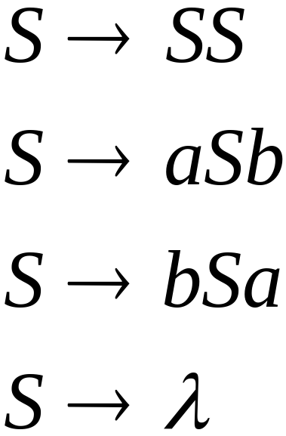
Example:
Find derivation of string
Exhaustive Parser
derivation
Input string
?

Slide 12
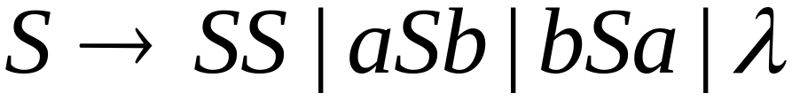
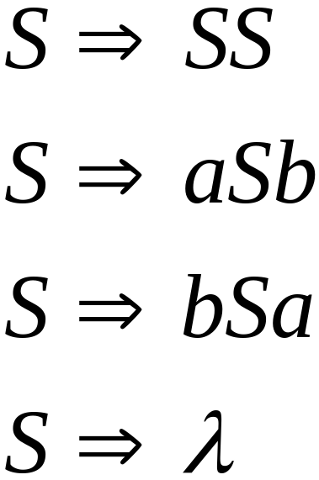
Exhaustive Search
Phase 1:
Find derivation
of
All possible derivations of length 1

Slide 13
Phase 1:
Find derivation
of
Cannot possibly produce

Slide 14
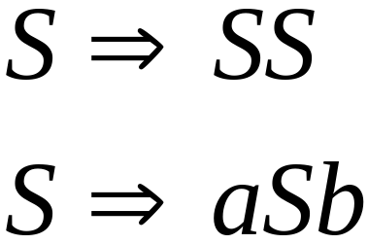
In Phase 2,
explore the next step
of each derivation
from Phase 1
Phase 1

Slide 15
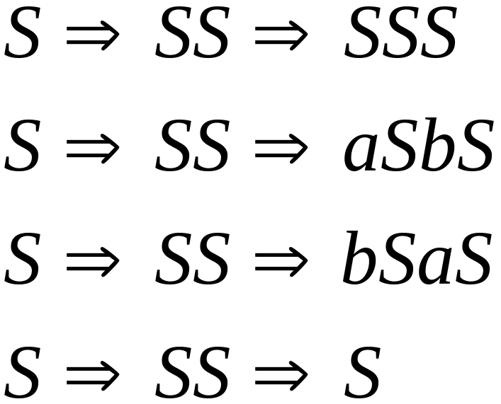
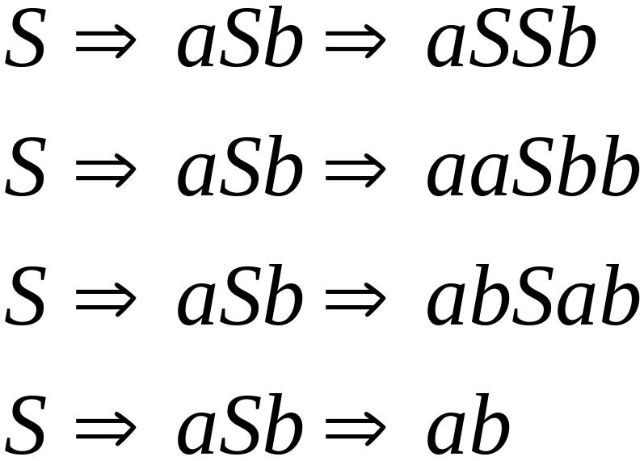
Phase 2
Phase 1
Find derivation
of

Slide 16
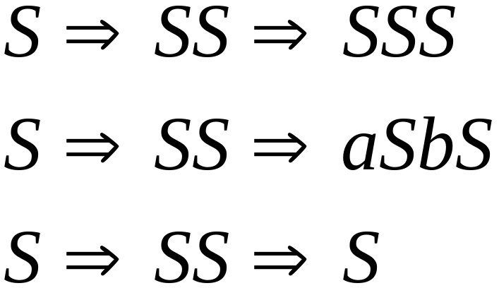
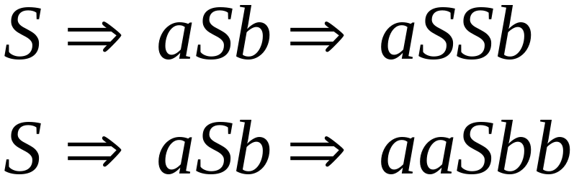
Phase 2
Find derivation
of
In Phase 3 explore
all possible derivations

Slide 17
Phase 2
Find derivation
of
A possible derivation
of Phase 3

Slide 18
Final result of exhaustive search
Exhaustive Parser
Input
string
derivation

Slide 19



Time Complexity
Suppose that the grammar does not have
productions of the form
( -productions)
(unit productions)

Slide 20
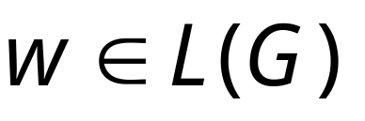
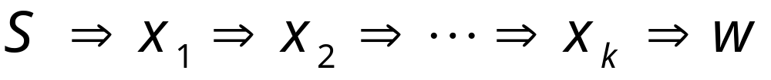
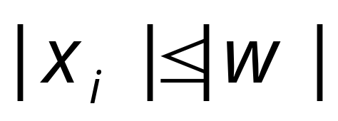

Since there are no -productions
For any derivation of a
string of terminals
it holds that
for all
Notes:
S->MN
M->null
S->MN->N

Slide 21
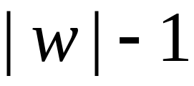
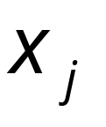


Since there are no unit productions
1. At most derivation steps are needed
to produce a string with at most
variables
2. At most derivation steps are needed
to convert the variables of to the
string of terminals
Notes:
S->AB
一分为二的特征：S->(2)->(3)->(4)->(5)

Slide 22
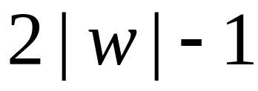


Therefore, at most derivation
steps are required to produce
The exhaustive search requires at most
phases

Slide 23


Suppose the grammar has productions
Possible derivation choices
to be examined in phase 1:
at most

Slide 24
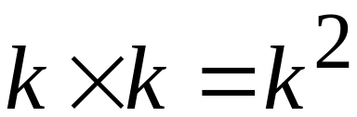
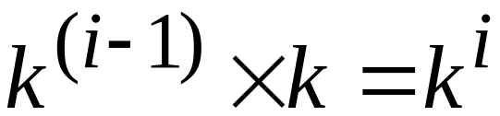
Choices for phase 2: at most
Choices of
phase 1
Number of
Productions
In General
Choices for phase i: at most
Choices of
phase i-1
Number of
Productions

Slide 25

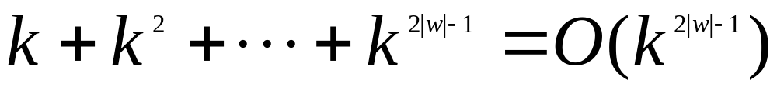
Total exploration choices for string :
phase 1
phase 2
phase 2|w|-1
Exponential to the string length
Extremely bad!!!

Slide 26
Faster Parsers

Slide 27



There exist faster parsing algorithms
for specialized grammars
S-grammar:
terminal
String of variables
Each pair of variable, terminal
appears once in a production
(a restricted version of Greinbach Normal form)

Slide 28
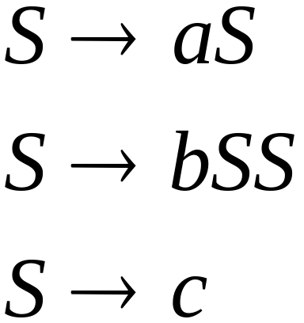
S-grammar example:
Each string has a unique derivation

Slide 29

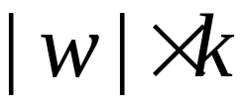
For S-grammars:
In the exhaustive search parsing
there is only one choice in each phase
Steps for a phase:
Total steps for parsing string :

Slide 30
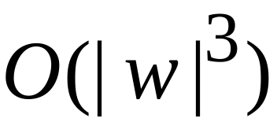

For general context-free grammars:
Next, we give a parsing algorithm
that parses a string in time
(this time is very close to the worst case
optimal since parsing can be used to solve
the matrix multiplication problem)

Slide 31


The CYK Parsing Algorithm
Input:
Arbitrary Grammar
in Chomsky Normal Form
String
Output:
Determine if
Number of Steps:
Can be easily converted to a Parser

Slide 32

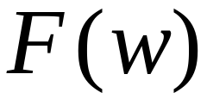
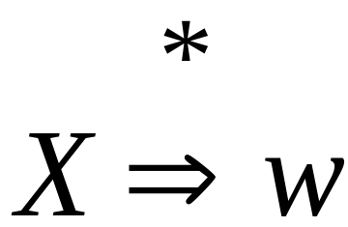
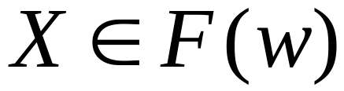
Basic Idea
Consider a grammar
In Chomsky Normal Form
Denote by the set of variables
that generate a string
if

Slide 33
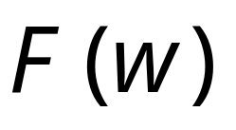
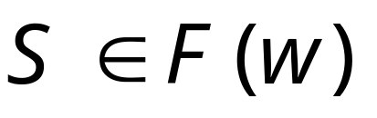
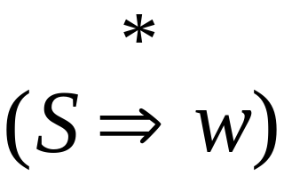
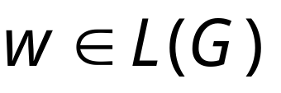
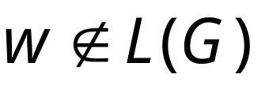
Suppose that we have computed
Check if :
YES
NO

Slide 34

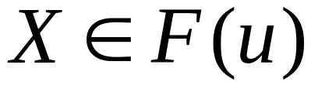
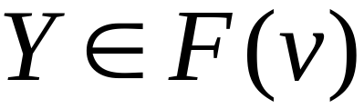
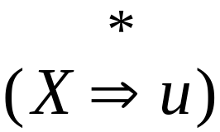
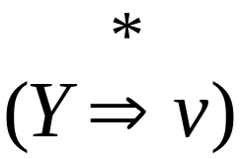
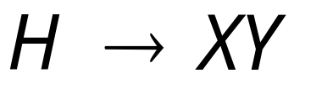
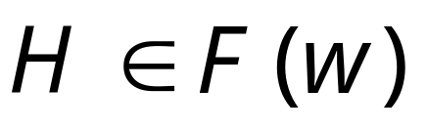
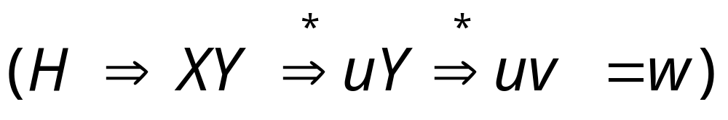
can be computed recursively:
prefix
suffix
Write
If
and
and there is production
Then

Slide 35
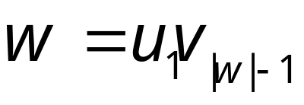

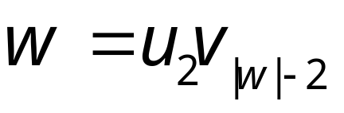

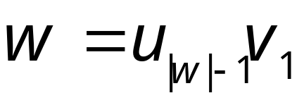
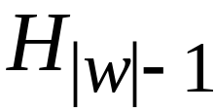
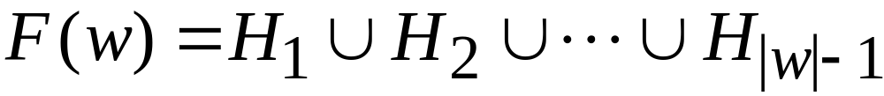
Examine all prefix-suffix
decompositions of
Length
Set of Variables
that generate
1
2
|w|-1
Result:

Slide 36
拆分字符串
Find derivation aabb
aabb= a abb
aabb= aa bb
aabb=aaa b
H->H(a)H(abb)
H->H(aa)H(bb)
H->H(aaa)H(b)
H(a)=Ф H(b)= Ф
H(aa)= Ф H(ab)={S} H(bb)= Ф
H(aab)=H(a) H(ab) U H(aa)H(b) ={S}
H(abb)=H(a)H(bb) U H(ab)H(b)={S}
H(aabb)={S}

Slide 37

At the basis of the recursion
we have strings of length 1
terminal
Very easy to find

Slide 38
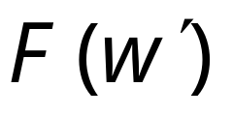
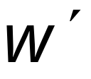
Remark:
The whole algorithm can be implemented
with dynamic programming:
First compute for smaller
substrings and then use this
to compute the result for larger
substrings of

Slide 39
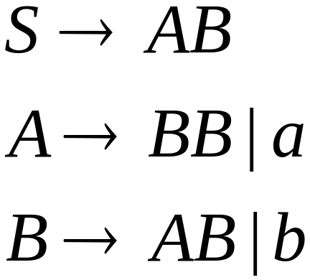
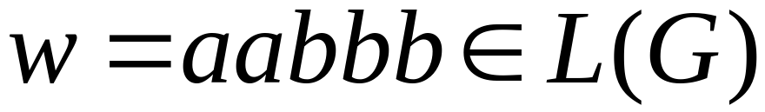
Example:
Grammar :
Determine if

Slide 40

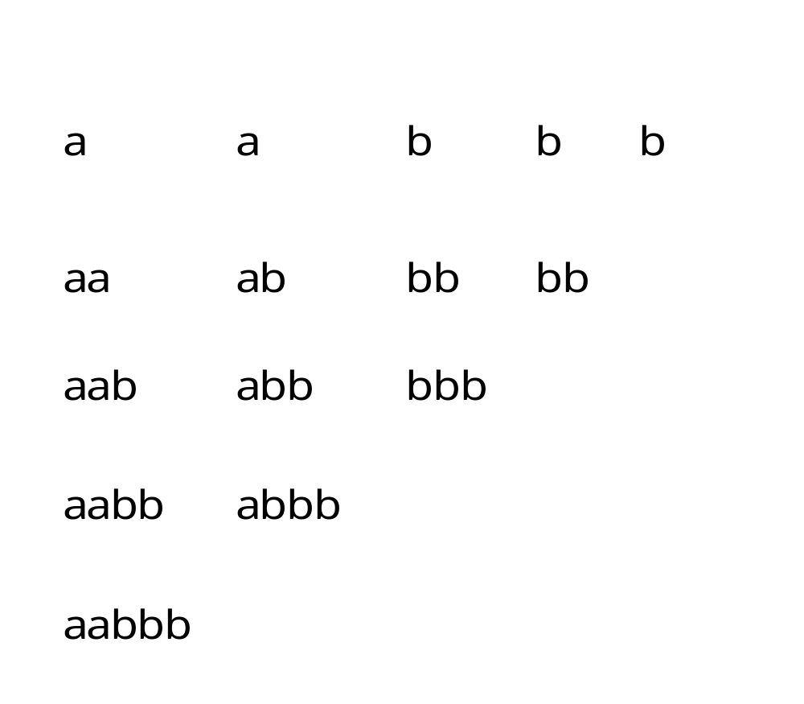
Decompose the string
to all possible substrings
Length
1
2
3
4
5

Slide 41
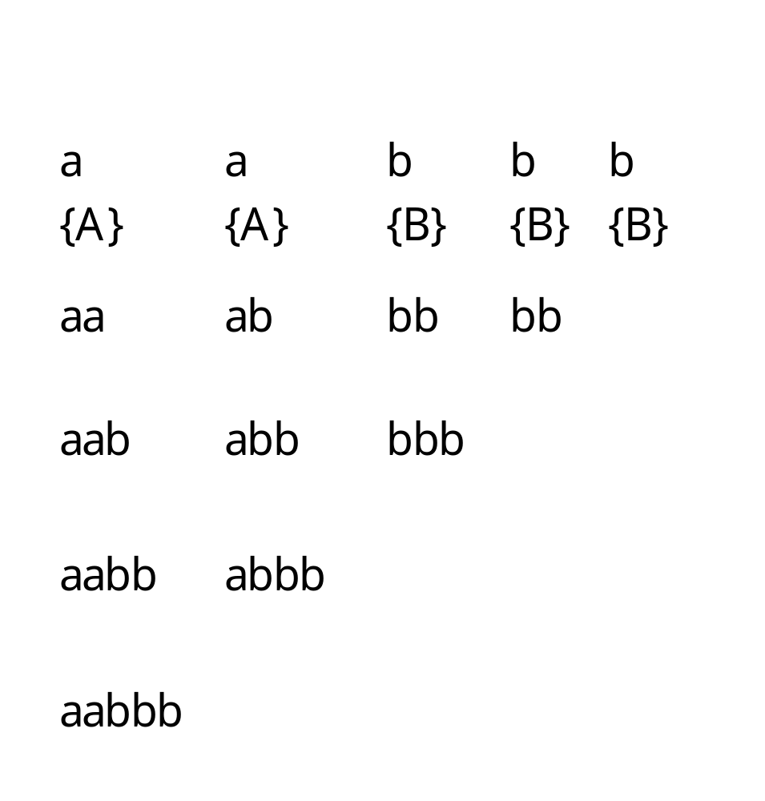


Slide 42
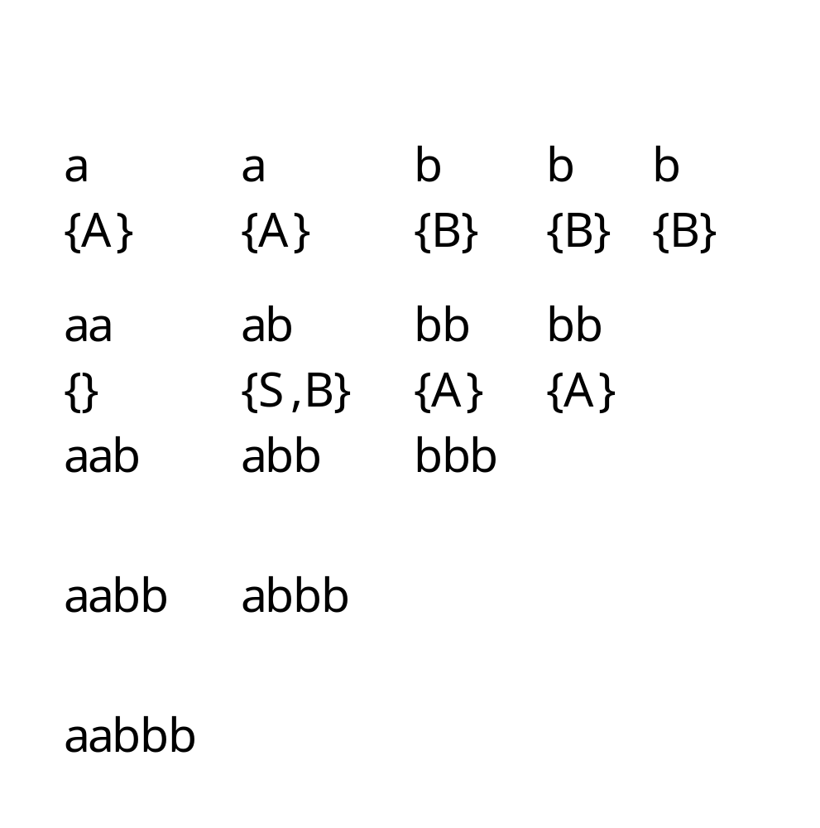
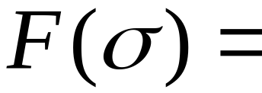
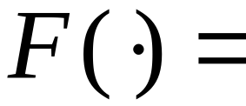

Slide 43











prefix
suffix
There is no production of form
Thus,
prefix
suffix
There are two productions of form
Thus,

Slide 44
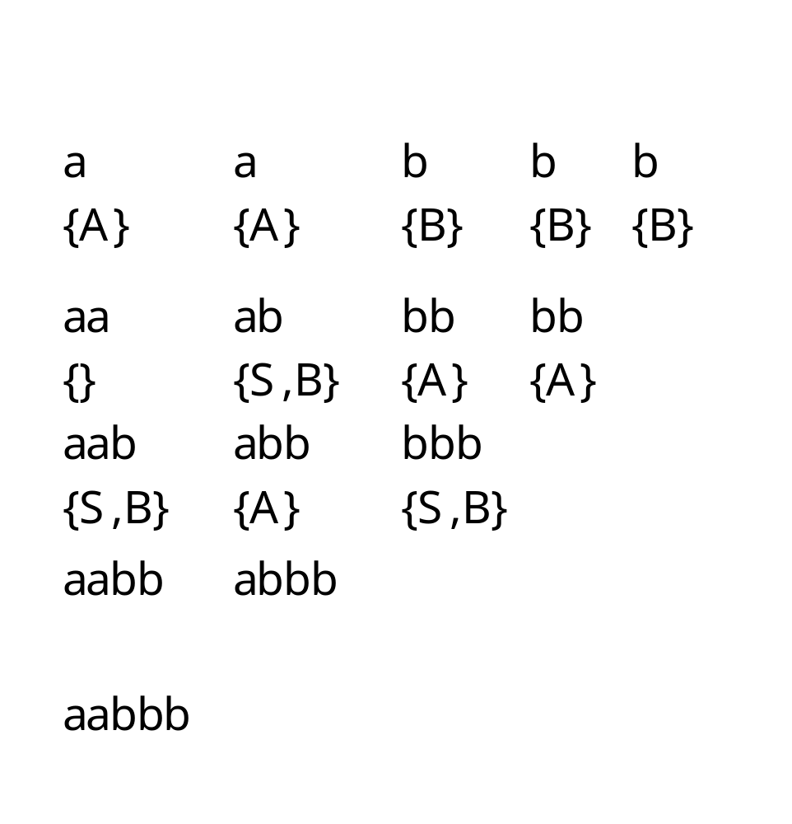

Slide 45







Decomposition 1
prefix
suffix
There is no production of form
There are 2 productions of form

Slide 46




Decomposition 2
prefix
suffix
There is no production of form

Slide 47




Since

Slide 48

Approximate time complexity:
Number of
Substrings
|w|+(|w|-1)+(|w|-2)+…+1
= |w|*(|w|+1)/2
Number of
Prefix-suffix
decompositions
for a string |w|-1
Notes:
aabbb
|w|+(|w|-1)+(|w|-2)+…1= |w|+(|w|-1)+(|w|-2)+…(|w|-(|w|-1)) = |w| *(|w|+1)/2

Slide 49
can be computed recursively:
prefix
suffix
Write
If
and
and there is production
Then

Slide 50
Examine all prefix-suffix
decompositions of
Length
Set of Variables
that generate
1
2
|w|-1
Result:

Slide 51
At the basis of the recursion
we have strings of length 1
terminal
Very easy to find

Slide 52

Any Questions?

